Slide 1

MovieHut.com the Essential Movie Search Engine
M.EIC PRI 2023/2024
Group G72

Slide 2
Main Motivation
Nowadays, it’s IMPOSSIBLE to know every movie that’s currently available.
As we are living in the age of social media, it’s not uncommon, while we scroll through one of the many apps, to come across:
Quotes from
movies
Still images from
a movie scene
Full movies
divided in parts
From films that we never heard of.

Slide 3


Data Selection

Slide 4
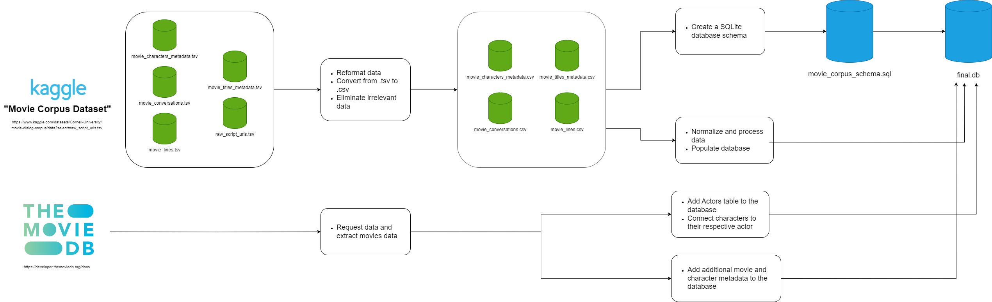
Data Processing and Pipeline

Slide 5
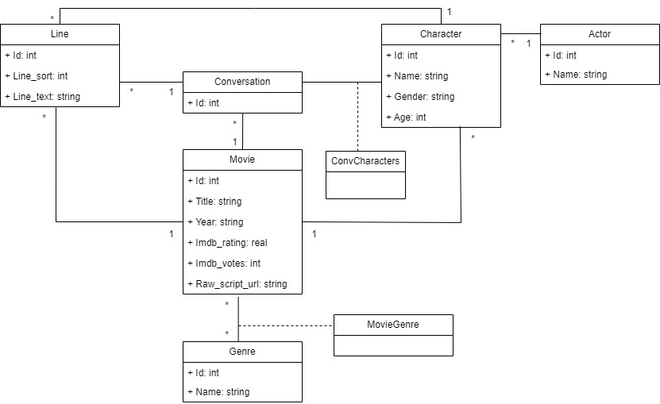
Data Conceptual Model

Slide 6
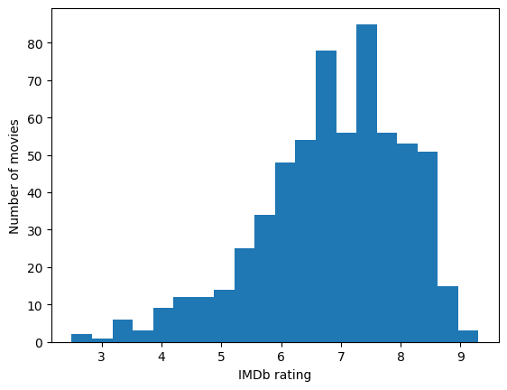
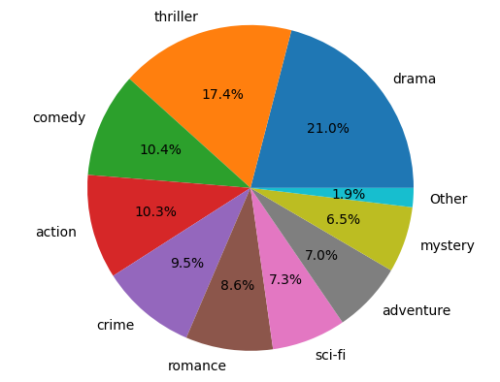
Data Characterization

Slide 7
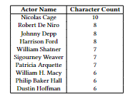
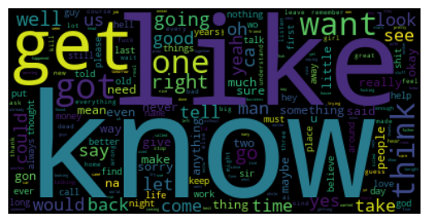
Data Characterization

Slide 8
Data Characterization

Slide 9
Search Scenarios
“In what movie did the actor X say Y?”
“Who said X?”
“What character is played by X in movie Y?”
“What did X say to Y in movie Z?”
“What movies did actor X play in?”

Slide 10
01
Name of the section
You can enter a subtitle here if you need it

Slide 11

Our team
Mercury is the closest planet to the Sun and the smallest one in the entire Solar System. This planet's name has nothing to do with the liquid metal, since Mercury was named after the Roman messenger god. Despite being closer to the Sun than Venus, its temperatures aren't as terribly hot as that planet's. Its surface is quite similar to that of Earth's Moon
Speaking of craters, many of them were named after artists or authors who made significant contributions to their respective fields. Mercury takes a little more than 58 days to complete its rotation, so try to imagine how long days must be there! Since the temperatures are so extreme, albeit not as extreme as in Venus, and the solar radiation is so high, Mercury has been deemed to be non-habitable for humans

Slide 12
—Someone Famous
“This is a quote, words full of wisdom that someone important said and can make the reader get inspired.”

Slide 13
Maybe you need to divide the content
Jupiter and Mars
Venus and Mercury
Jupiter is a gas giant and the biggest planet in the Solar System. It's the fourth-brightest object in the night sky. It was named after the Roman god of the skies and lightning
Despite being red, Mars is actually a cold place. It's full of iron oxide dust
Venus has a beautiful name and is the second planet from the Sun. It’s terribly hot, even hotter than Mercury, and its atmosphere is extremely poisonous
Mercury is the closest planet to the Sun and the smallest one in the Solar System

Slide 14

A picture is worth a thousand words

Slide 15
Slide with longer text
Mercury is the closest planet to the Sun and the smallest of them all. This planet's name has nothing to do with the liquid metal, since Mercury was named after the Roman messenger god. Despite being closer to the Sun than Venus, its temperatures aren't as terribly hot as that planet's. Its surface is quite similar to that of Earth's Moon, which means there are a lot of craters and plains. Speaking of craters, many of them were named after artists or authors who made significant contributions to their respective fields. Mercury takes a little more than 58 days to complete its rotation, so try to imagine how long days must be there! Since the temperatures are so extreme, albeit not as extreme as in Venus, and the solar radiation is so high, Mercury has been deemed to be non-habitable for humans
Mercury is the closest planet to the Sun and the smallest of them all. This planet's name has nothing to do with the liquid metal, since Mercury was named after the Roman messenger god. Despite being closer to the Sun than Venus, its temperatures aren't as terribly hot as that planet's. Its surface is quite similar to that of Earth's Moon, which means there are a lot of craters and plains. Speaking of craters, many of them were named after artists or authors who made significant contributions to their respective fields. Mercury takes a little more than 58 days to complete its rotation, so try to imagine how long days must be there! Since the temperatures are so extreme, albeit not as extreme as in Venus, and the solar radiation is so high, Mercury has been deemed to be non-habitable for humans

Slide 16
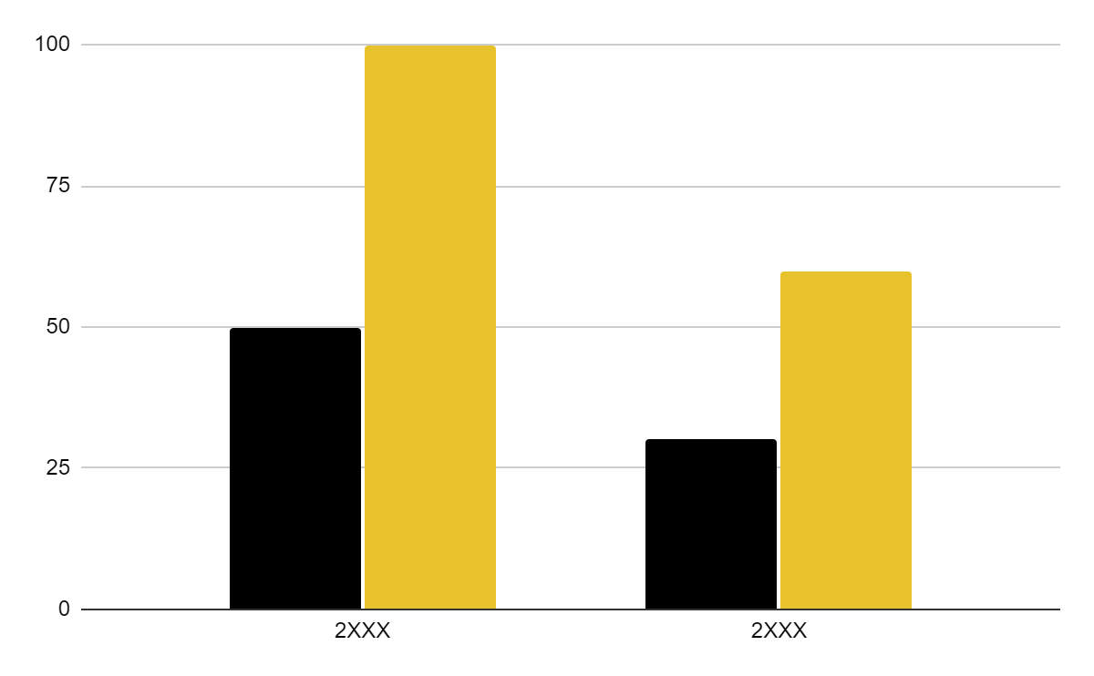
You can use this graph
Mercury
Jupiter
Mercury is the smallest planet of them all
Jupiter is the biggest planet of them all
Follow the link in the graph to modify its data and then paste the new one here. For more info, click here

Slide 17
Thanks!
Do you have any questions?
youremail@freepik.com
+34 654 321 432
yourwebsite.com
Please keep this slide for attribution

Slide 18
Alternative resources
Here’s an assortment of alternative resources whose style fits that of this template:

Slide 19
Resources
Did you like the resources on this template? Get them for free at our other websites:
Vectors
Lifestyle instagram post design template
Photos
Colleagues doing team work for a project I
Colleagues doing team work for a project II
Business woman banner concept with copy space

Slide 20
Instructions for use
If you have a free account, in order to use this template, you must credit Slidesgo by keeping the Thanks slide. Please refer to the next slide to read the instructions for premium users.
As a Free user, you are allowed to:
Modify this template.
Use it for both personal and commercial projects.
You are not allowed to:
Sublicense, sell or rent any of Slidesgo Content (or a modified version of Slidesgo Content).
Distribute Slidesgo Content unless it has been expressly authorized by Slidesgo.
Include Slidesgo Content in an online or offline database or file.
Offer Slidesgo templates (or modified versions of Slidesgo templates) for download.
Acquire the copyright of Slidesgo Content.
For more information about editing slides, please read our FAQs or visit Slidesgo School:
https://slidesgo.com/faqs and https://slidesgo.com/slidesgo-school

Slide 21
Instructions for use (premium users)
As a Premium user, you can use this template without attributing Slidesgo or keeping the Thanks slide.
You are allowed to:
Modify this template.
Use it for both personal and commercial purposes.
Hide or delete the “Thanks” slide and the mention to Slidesgo in the credits.
Share this template in an editable format with people who are not part of your team.
You are not allowed to:
Sublicense, sell or rent this Slidesgo Template (or a modified version of this Slidesgo Template).
Distribute this Slidesgo Template (or a modified version of this Slidesgo Template) or include it in a database or in any other product or service that offers downloadable images, icons or presentations that may be subject to distribution or resale.
Use any of the elements that are part of this Slidesgo Template in an isolated and separated way from this Template.
Register any of the elements that are part of this template as a trademark or logo, or register it as a work in an intellectual property registry or similar.
For more information about editing slides, please read our FAQs or visit Slidesgo School:
https://slidesgo.com/faqs and https://slidesgo.com/slidesgo-school

Slide 22
Fonts & colors used
This presentation has been made using the following fonts:
Playfair Display
(https://fonts.google.com/specimen/Playfair+Display)
Roboto
(https://fonts.google.com/specimen/Roboto)
#000000
#f0f0f0
#e7c22c
#ffffff

Slide 23



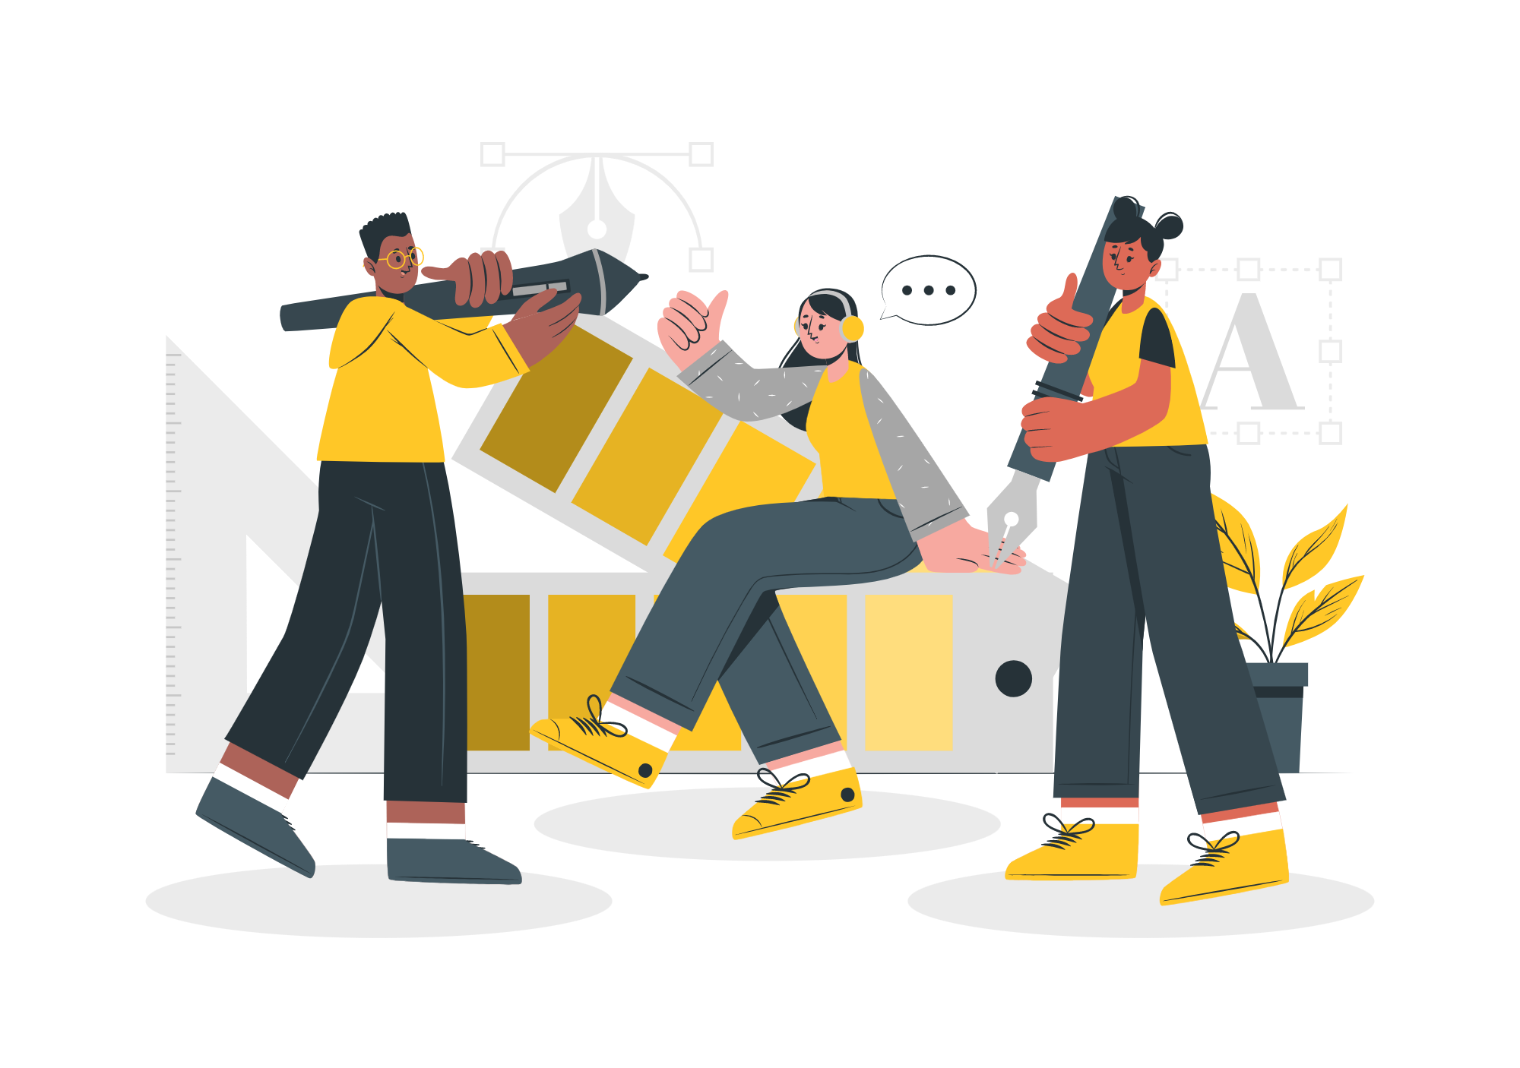

Storyset
Create your Story with our illustrated concepts. Choose the style you like the most, edit its colors, pick the background and layers you want to show and bring them to life with the animator panel! It will boost your presentation. Check out how it works.
Pana
Amico
Bro
Rafiki
Cuate

Slide 24
Use our editable graphic resources...
You can easily resize these resources without losing quality. To change the color, just ungroup the resource and click on the object you want to change. Then, click on the paint bucket and select the color you want. Group the resource again when you’re done. You can also look for more infographics on Slidesgo.

Slide 27
JANUARY
FEBRUARY
MARCH
APRIL
MAY
JUNE
PHASE 1
Task 1
Task 2
PHASE 2
Task 1
Task 2
JANUARY
FEBRUARY
MARCH
APRIL
PHASE 1
Task 1
Task 2

Slide 30
...and our sets of editable icons
You can resize these icons without losing quality.
You can change the stroke and fill color; just select the icon and click on the paint bucket/pen.
In Google Slides, you can also use Flaticon’s extension, allowing you to customize and add even more icons.

Slide 31
Educational Icons
Medical Icons

Slide 32
Business Icons
Teamwork Icons

Slide 33
Help & Support Icons
Avatar Icons

Slide 34
Creative Process Icons
Performing Arts Icons

Slide 35
Nature Icons

Slide 36
SEO & Marketing Icons

Slide 37


